Slide 1
Tungsten Tip Etching
Lee Jong Geon

Slide 2
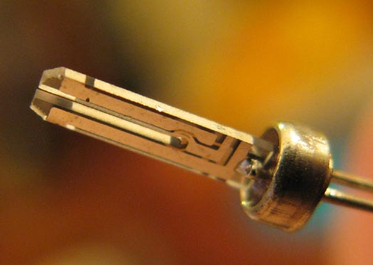
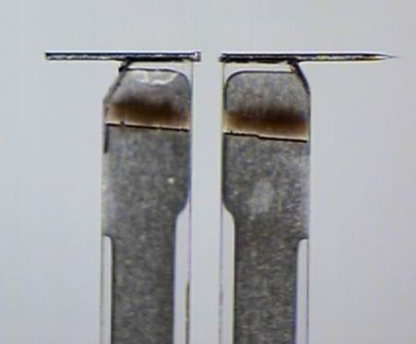
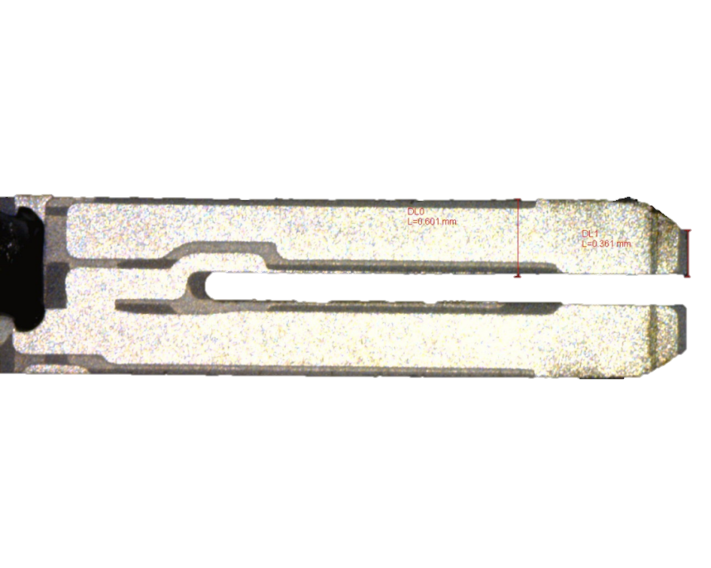
Atomic Force Microscopy (AFM)
Tungsten
High mechanical strength
High melting point
Simple electrochemical etching
Quartz Crystal Oscillator

Slide 3
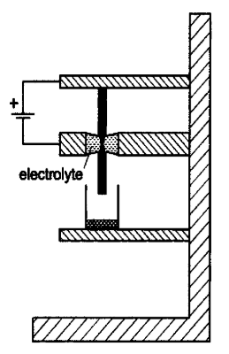
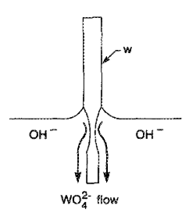
Tungsten Tip Etching
cathode
anode

Slide 4
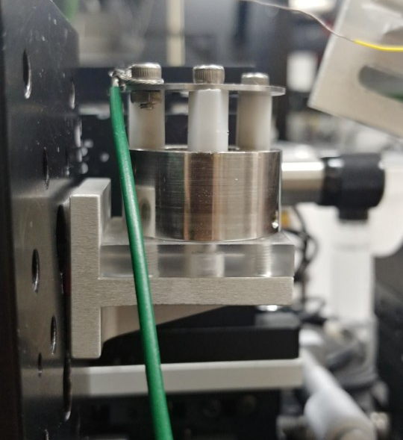
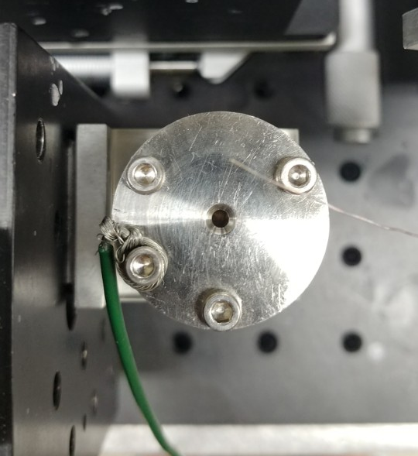
Current System
Anode
Cathode
NaOH

Slide 5
Process
준비물: 피펫(< 10 µL), 면봉, NaOH (1 M), Water
# 1
Tungsten tip에 방해되지 않도록 stage는 내리고, (+) wire 앞으로 움직인다.

Slide 6
Process
# 1
Stage, power supply, 전류계를 직렬로 연결한다.

